Slide 1
Fundamentals of Edge Computing

Slide 2
Edge Computing
Edge computing is a term used to describe intelligent computational resources located close to the source of data consumption or generation
what the edge is and oftentimes it depends on your perspective but from iot analytics perspective edge computing

Slide 3
FUNDAMENTALS OF EDGE COMPUTING
Edge computing has become an important solution to break the bottleneck of emerging technologies by virtue of its advantages of reducing data transmission, improving service latency and easing cloud computing pressure.
The edge computing architecture will become an important complement to the cloud, even replacing the role of the cloud in some scenarios.

Slide 4
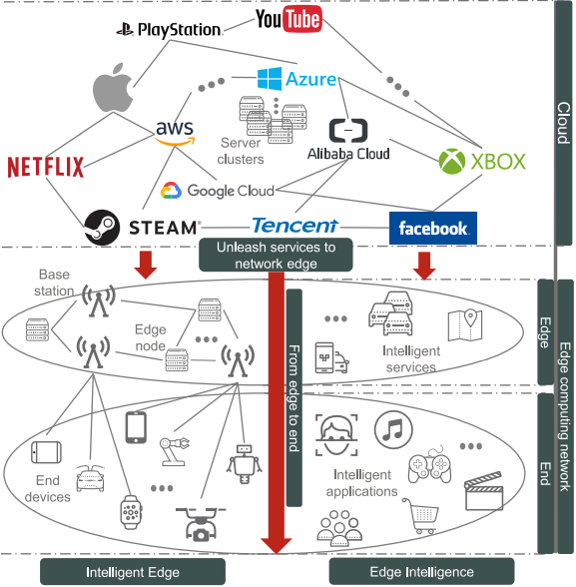

Slide 5
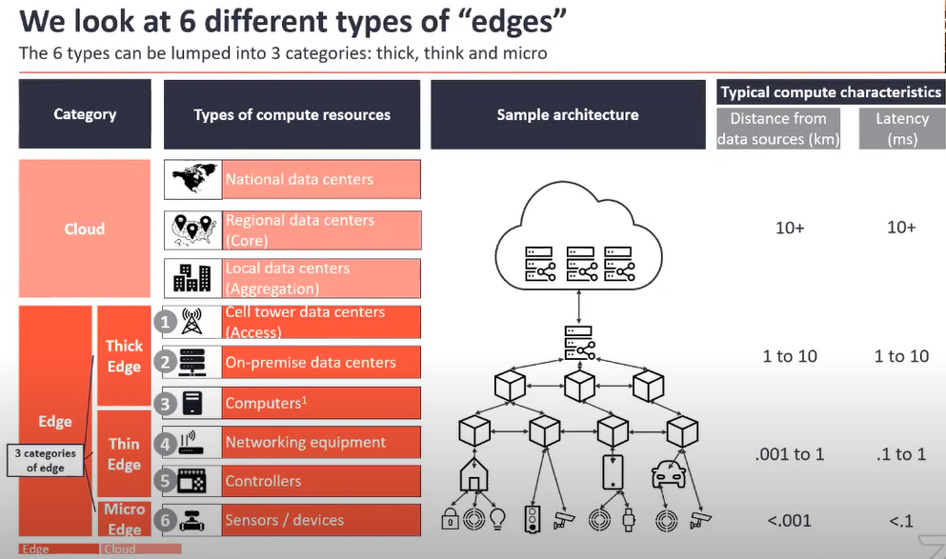

Slide 6
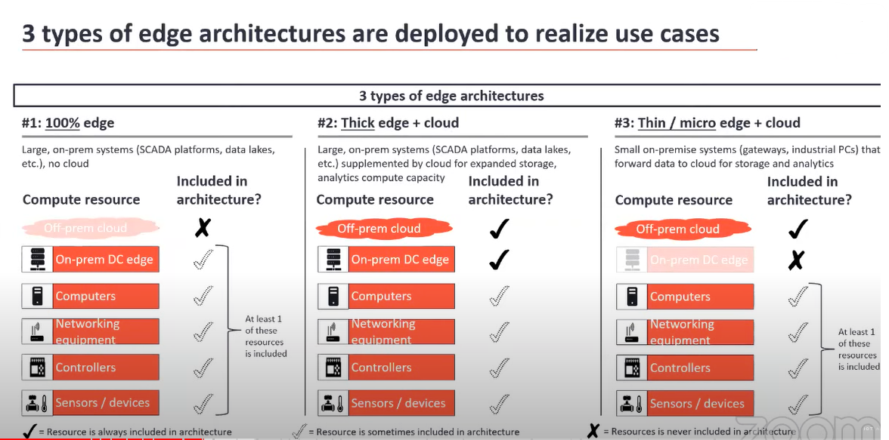

Slide 7
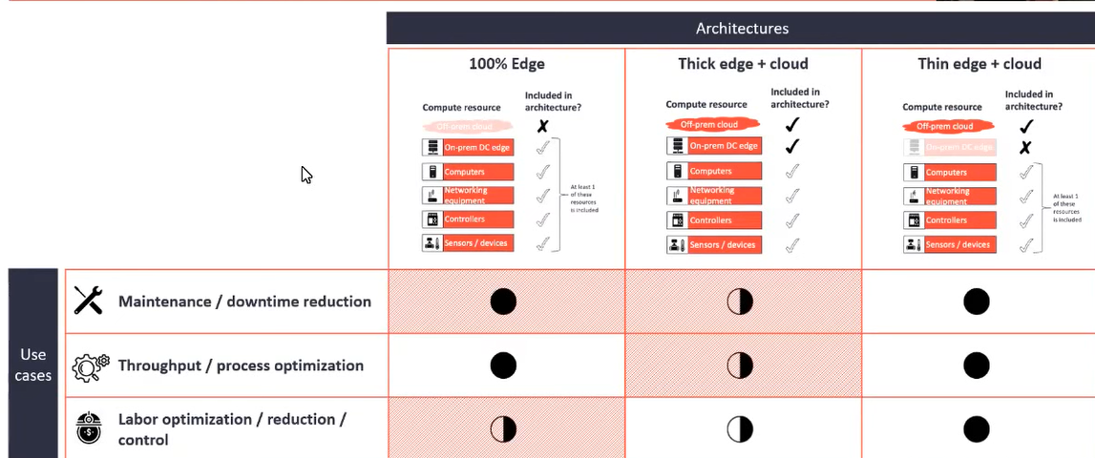

Slide 8
Paradigms of Edge Computing
In the development of edge computing, there have been various new technologies aimed at working at the edge of the network, with the same principles but different focuses,
such as Cloudlet, Micro Data Centers (MDCs), Fog Computing and Mobile Edge Computing (viz., Multi-access Edge Computing- now)
However, the edge computing community has not yet reached a consensus on the standardized definitions, architectures and protocols of edge computing].
We use a common term “edge computing” for this set of emerging technologies

Slide 9
Cloudlet and Micro Data Centers
Cloudlet is a network architecture element that combines mobile computing and cloud computing.
It represents the middle layer of the three-tier architecture, i.e., mobile devices, the micro cloud, and the cloud.
Its highlights are efforts to 1) define the system and create algorithms that support low-latency edge cloud computing, and 2) implement related functionality in open source code as an extension of Open Stack cloud management software .
Similar to Cloudlets, MDCs are also designed to complement the cloud. The idea is to package all the computing, storage, and networking equipment needed to run customer applications in one enclosure, as a stand-alone secure computing environment, for applications that require lower latency or end devices with limited battery life or computing abilities.

Slide 10
Fog Computing
One of the highlights of fog computing is that it assumes a fully distributed multi-tier cloud computing architecture with billions of devices and large-scale cloud data centers
While cloud and fog paradigms share a similar set of services, such as computing, storage, and networking, the deployment of fog is targeted to specific geographic areas.
In addition, fog is designed for applications that require real-time responding with less latency, such as interactive and IoT applications.
Unlike Cloudlet, MDCs and MEC, fog computing is more focused on IoTs

Slide 11
Mobile (Multi-Access) Edge Computing (MEC):
Mobile Edge Computing places computing capabilities and service environments at the edge of cellular networks.
It is designed to provide lower latency, context and location awareness, and higher bandwidth.
Deploying edge servers on cellular Base Stations (BSs) allows users to deploy new applications and services flexibly and quickly.
The European Telecommunications Standards Institute (ETSI) further extends the terminology of MEC from Mobile Edge Computing to Multi-access Edge Computing by accommodating more wireless communication technologies, such as Wi-Fi.

